Slide 1
Revision for
Data Science (Machine Learning)

Slide 2
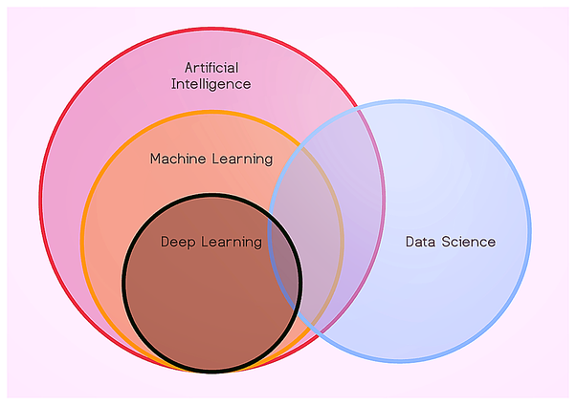
What is Data Science?
Field of study that aims to use a scientific approach to extract
meaning and insights from data.

Slide 3
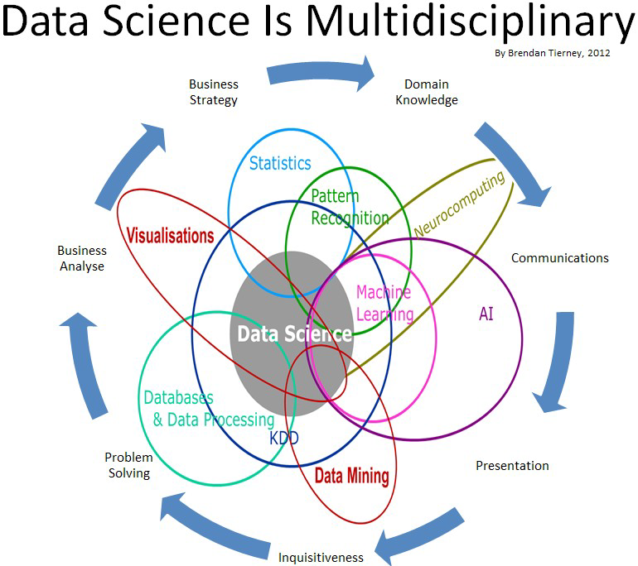
What is Data Science?

Slide 4
What is Machine Learning?
Machine Learning enables computers to learn from data, and improves themselves without explicitly programmed.

Slide 5
What is Artificial Intelligence?
Study of how to train the computers so that computers can do things
which at present human can do better.

Slide 6
Machine Learning:
Machine learning is a subset of AI which allows a machine to automatically learn from past data without programming explicitly.
Machine learning enables a computer system to make predictions or take some decisions using historical data without being explicitly programmed.
It uses a massive amount of structured data so that a machine learning model can generate accurate result or give predictions based on that data.

Slide 7
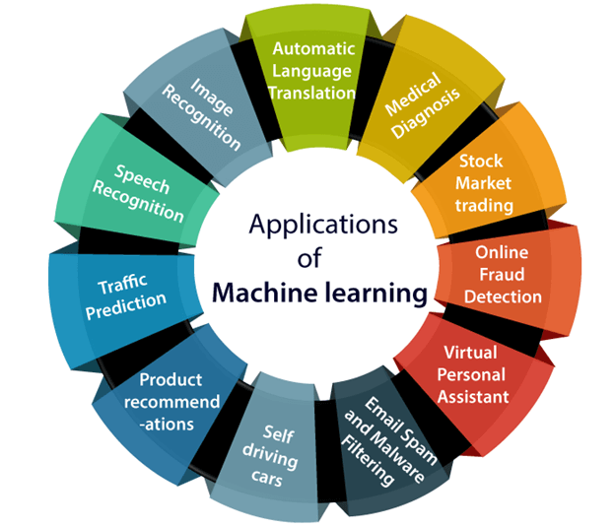
Applications of Machine Learning:

Slide 8


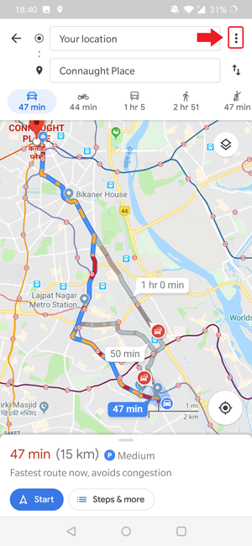
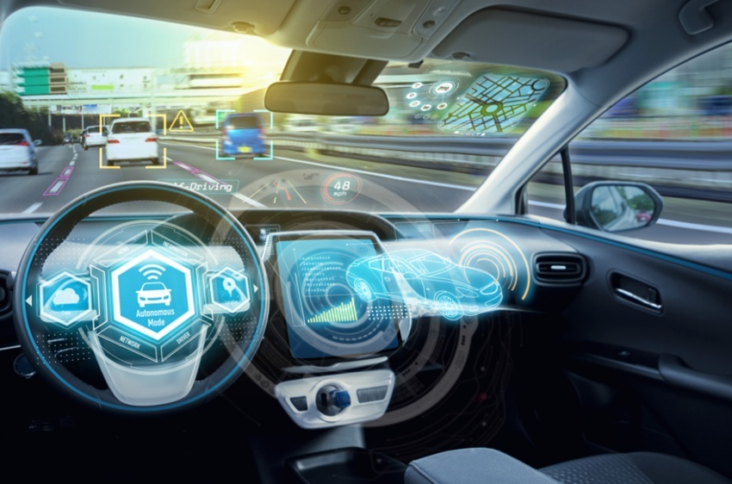
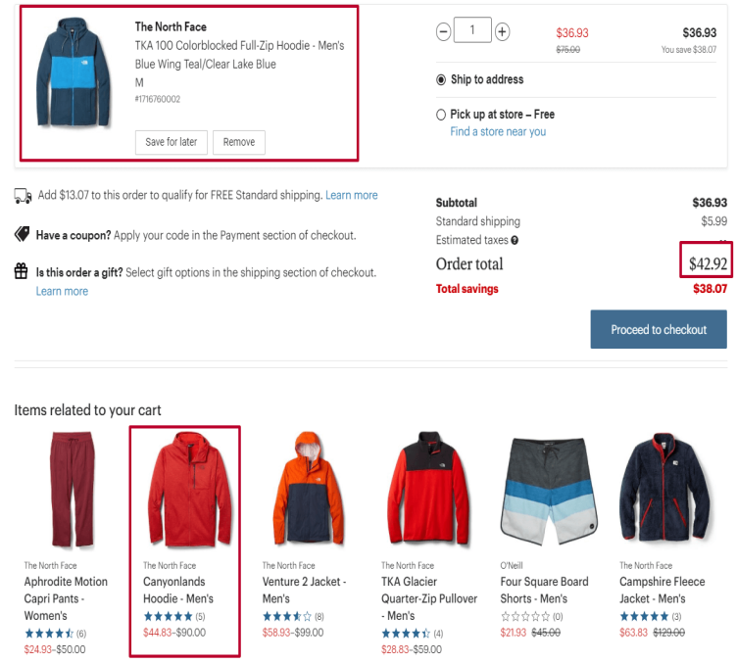

Applications of Machine Learning:

Slide 9
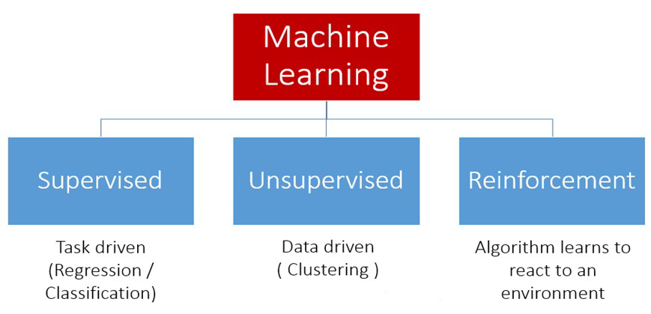
Machine Learning Types:
Supervised Learning Un-supervised Learning Reinforcement Learning.
Predictive Model Descriptive Model Awards based model

Slide 10
